Slide 1

Twitter Sentiment Classification Using Neural Network
Shovan Chowdhury
MS Student

Slide 2




Contents
Contents
Dataset
Preview your main points
Methodology
Result Analysis
Conclusion

Slide 3

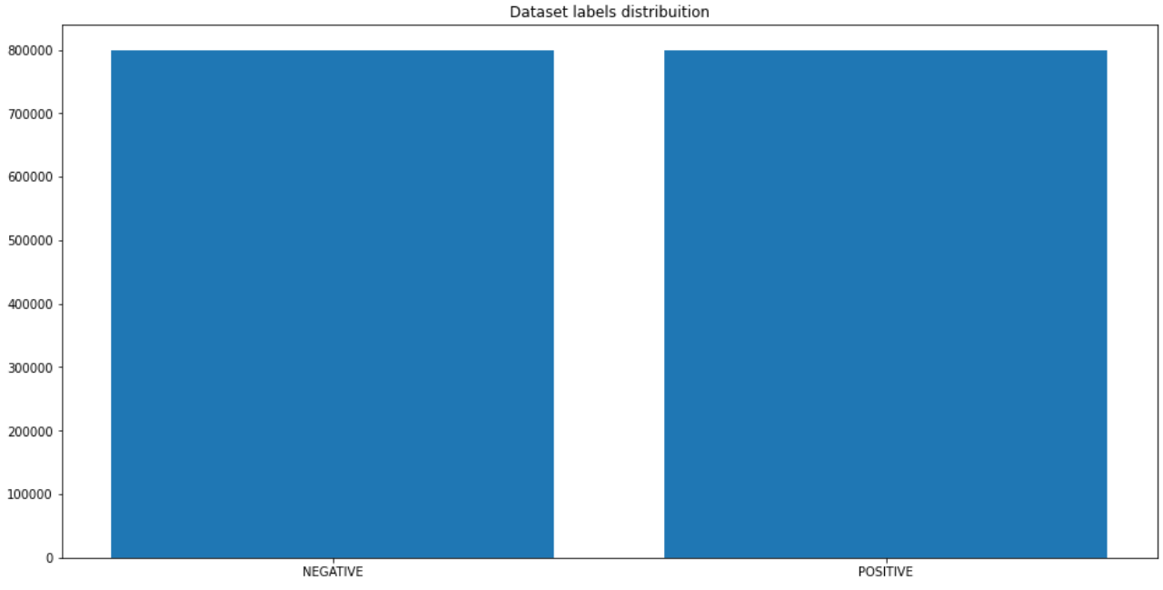
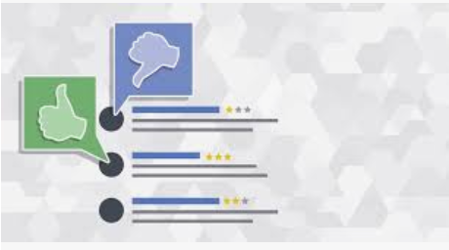
Dataset
1.6 Million tweet observations regarding movie reviews, politics, products
2 types of sentiment (Positive & Negative)
MOTIVATION
Predict election outcomes or market trends from sentiment analysis
Data Source: https://www.kaggle.com/kazanova/sentiment140
Notes:
Talk about the ordinal nature of the target variable as well as the scaledness of the predictors. Mention that the dataset contains no missing values and no preprocessing was needed or performed.

Slide 4
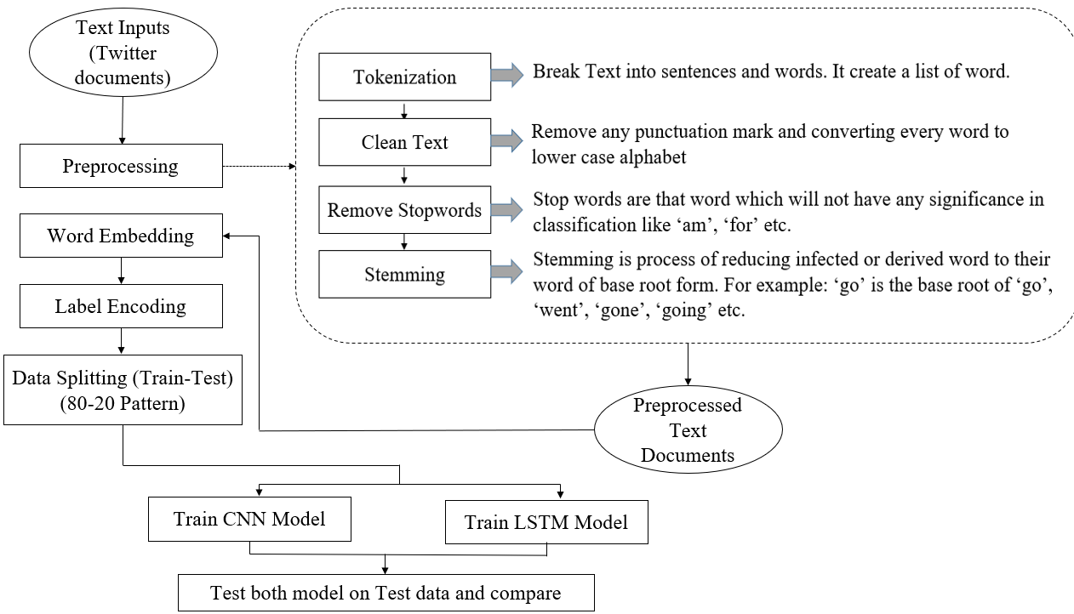
Methodology(Overview)
Notes:
Talk about the ordinal nature of the target variable as well as the scaledness of the predictors. Mention that the dataset contains no missing values and no preprocessing was needed or performed.

Slide 5
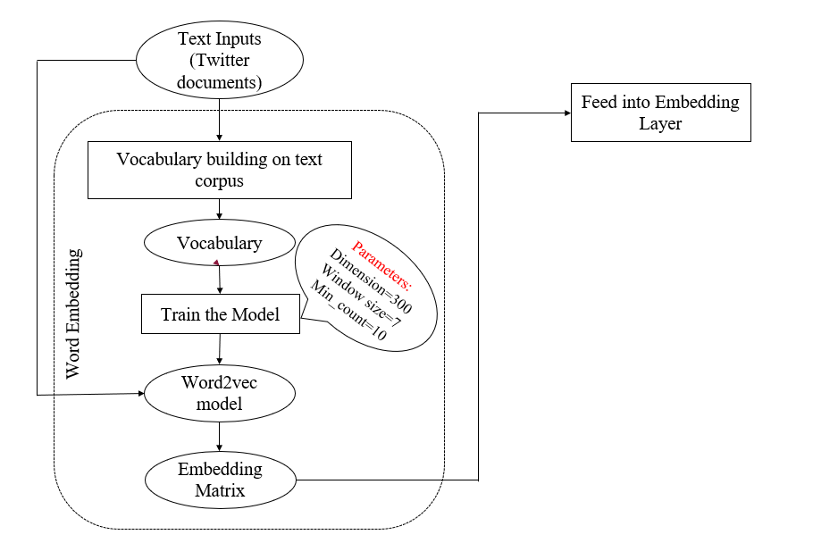

Word Embedding
Word2vec – a two layer neural network model providing a dense representation of words and their relative meanings.
Continuous Bag of words(CBOW) algorithm has been use to train the model.
Embedding matrix weight will be frozen in embedding layer.
Notes:
We are using Google’s word2vec model to get contextual word vector. We are training this model using our own vocabulary.
Dimension of vector we have mentioned is 300, window size 7, min_count 10

Slide 6
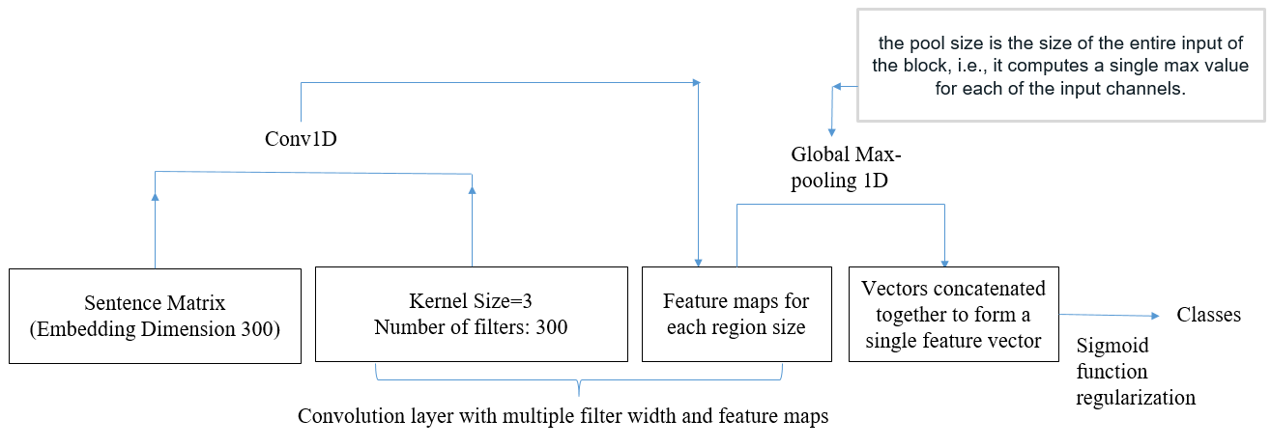
Methodology(CNN)
Notes:
Talk about the ordinal nature of the target variable as well as the scaledness of the predictors. Mention that the dataset contains no missing values and no preprocessing was needed or performed.

Slide 7
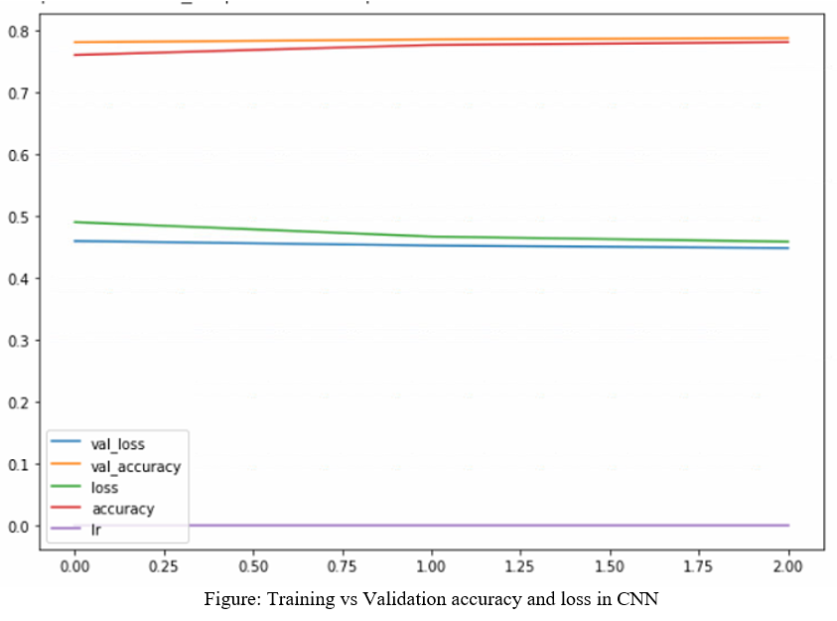
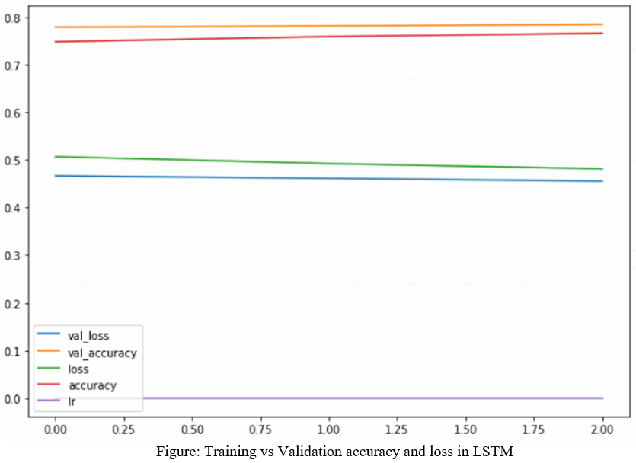
Result Analysis
Algortihm | Train accuracy | Validation Accuracy | Test Accuracy
CNN | 0.7810 | 0.7874 | 0.7871
LSTM | 0.7658 | 0.7844 | 0.7854
Notes:
Talk about the ordinal nature of the target variable as well as the scaledness of the predictors. Mention that the dataset contains no missing values and no preprocessing was needed or performed.

Slide 8
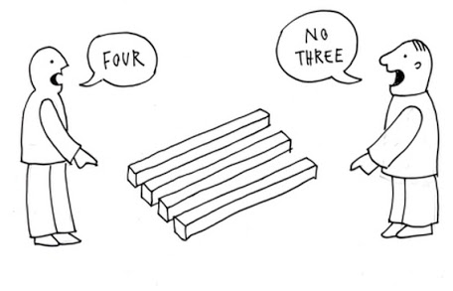
CONCLUSION
Conclusion
It takes lots of time to run textual data
CNN and LSTM both perform equally well in this project
8

Slide 9
THANK YOU

